Slide 1
Prediction Market Exploratory Data Analysis
Vincent Nguyen, Vinod Srinivasan, Kasyap Bendapudi

Slide 2
Introduction
Research Question
Exploratory Data Analysis (EDA) of Polymarket to evaluate market and trader behavior.
Dataset
Over 1.5M markets tracked across categories (Sports, Politics, Crypto, Economics).
Resolutions: Settlement outcomes (YES/NO) across standard and multi-choice markets.
Wallet Trades: Transaction logs tracking trade sizes, timing, and profitability.

Slide 3
Introduction
Scope of our EDA
How are volume, trading activity, and new markets distributed?
Are prices well-calibrated, and do larger markets offer better liquidity?
When and how do traders earn positive returns? (timing, size, specialization)?

Slide 4
Markets Metadata

Slide 5
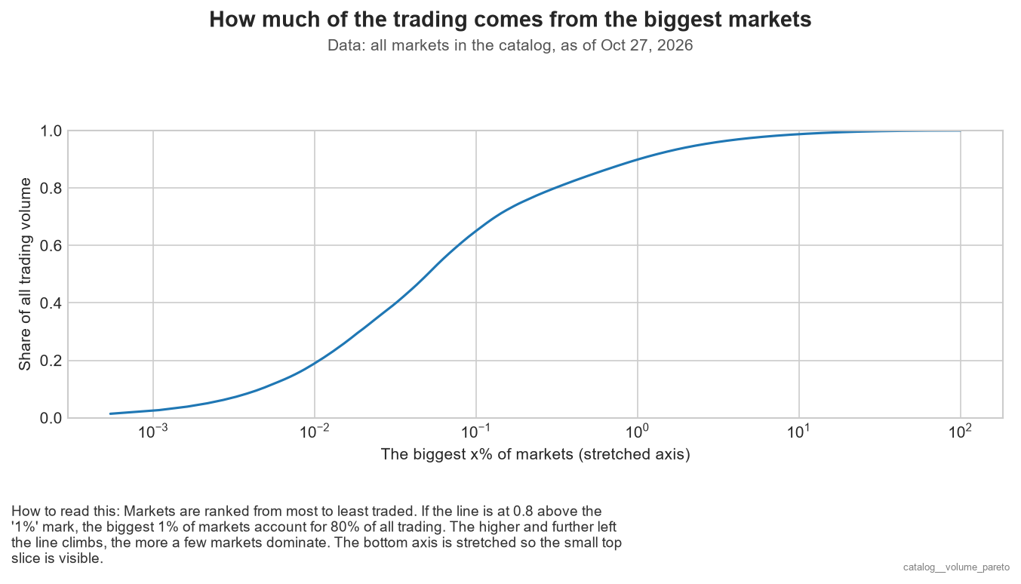
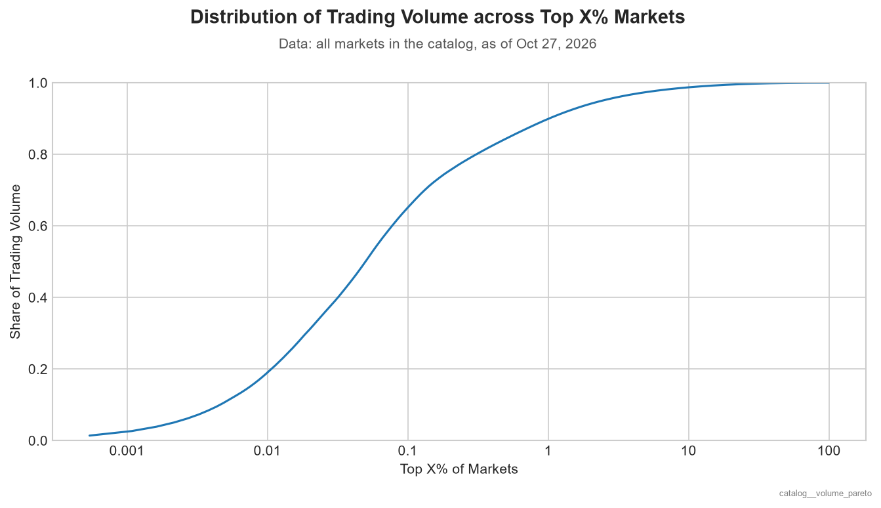
Data: Markets
Notes:
This ranks markets from most to least traded. The bottom axis is the top X% of markets, stretched so we can see the top slice, and the side axis is their share of all volume.
The top 1% of markets hold about 90% of all volume, and the top 0.1% hold about 65%. So a tiny number of markets get almost all the money, and most markets barely trade.

Slide 6
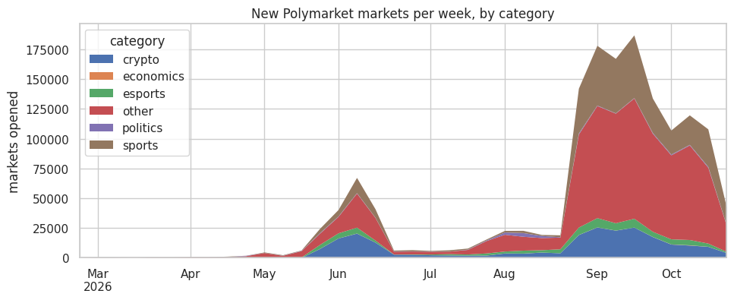
Data: Markets
Polymarket grew in late August and peaked in September
New markets rose from ~20K to 175K+ per week
Sports and crypto make up a large share of new markets
Notes:
This shows new markets opened each week. The colors are categories we assigned from keywords in the market names, and “other” means no keyword matched.
Polymarket was small until May. Then it exploded in September, from about 20,000 to over 175,000 new markets a week. A lot of that is sports and crypto, which create many short, repeated markets, like single games or 15-minute Bitcoin bets.

Slide 7
Resolutions Metadata

Slide 8
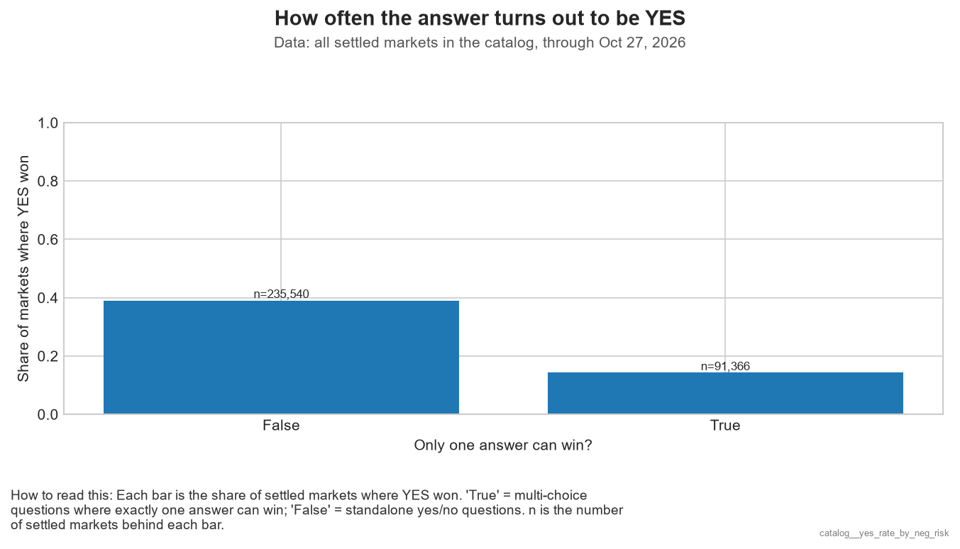
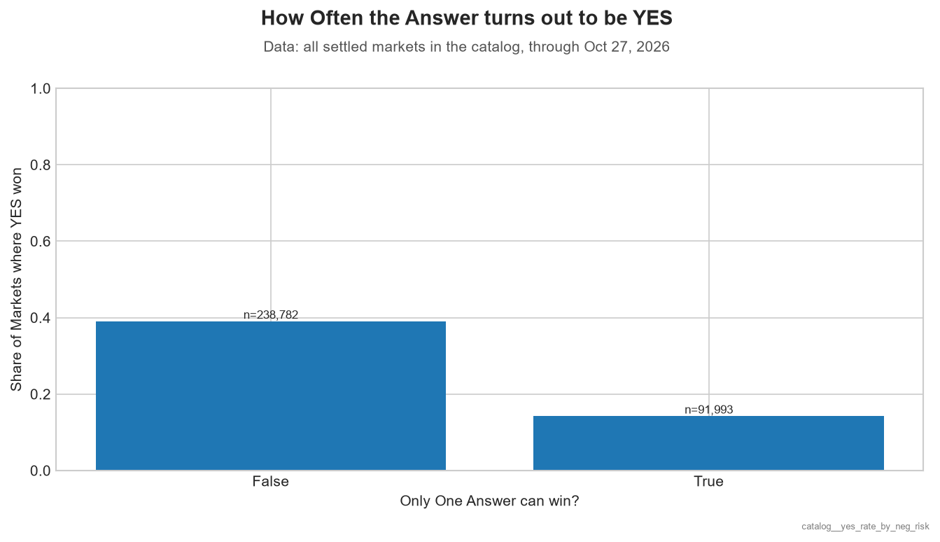
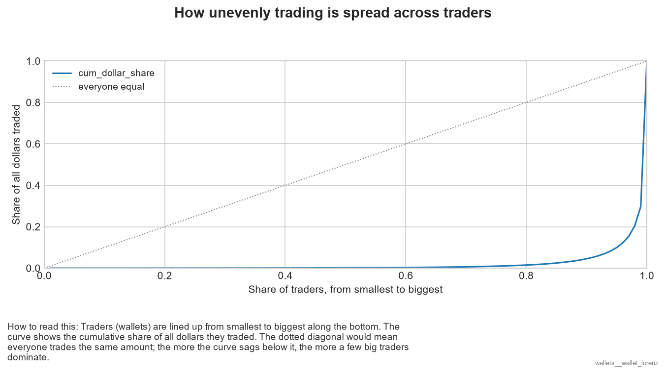
Data: Resolutions
Notes:
In the False, we can think of it as separate non-mutually exclusive questions. Think of it as two separate threshold/margin questions pertaining to the same subject, each with their own binary yes/no (e.g. Bitcoin crossing 100K vs 125K). So, True pertains to questions that are truly mutually exclusive and likely only have one market per event.
Basically, think of it as ‘False’ providing more chances to “win”.

Slide 9
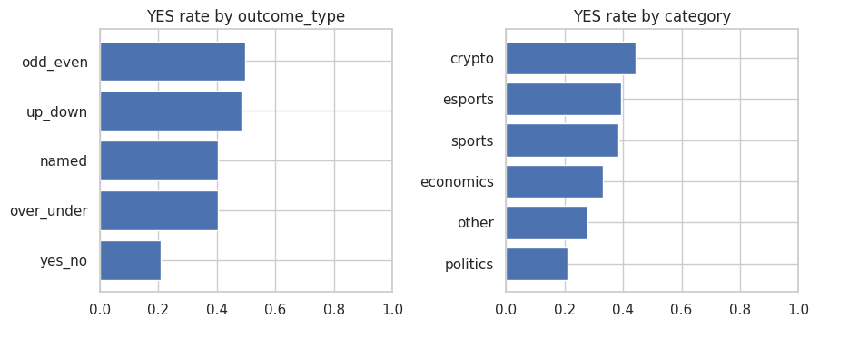
Data: Markets x Resolutions
Real Yes/No questions resolve YES only ~21% of the time.
Up/Down and Odd/Even markets are ~50/50,
Politics has the lowest YES rate (~21%); crypto the highest (~44%), driven by coin-flip markets.
Notes:
This shows how often YES wins by outcome type and by category. A longer bar means YES wins more often.
Real Yes/No questions resolve YES only about 21% of the time, while Up/Down and Odd/Even markets are basically coin flips at 50%.
By category, politics is lowest at 21% because most candidates lose, and crypto is highest at 44% because most crypto markets are coin flips.

Slide 10
Wallet Trade Data

Slide 11
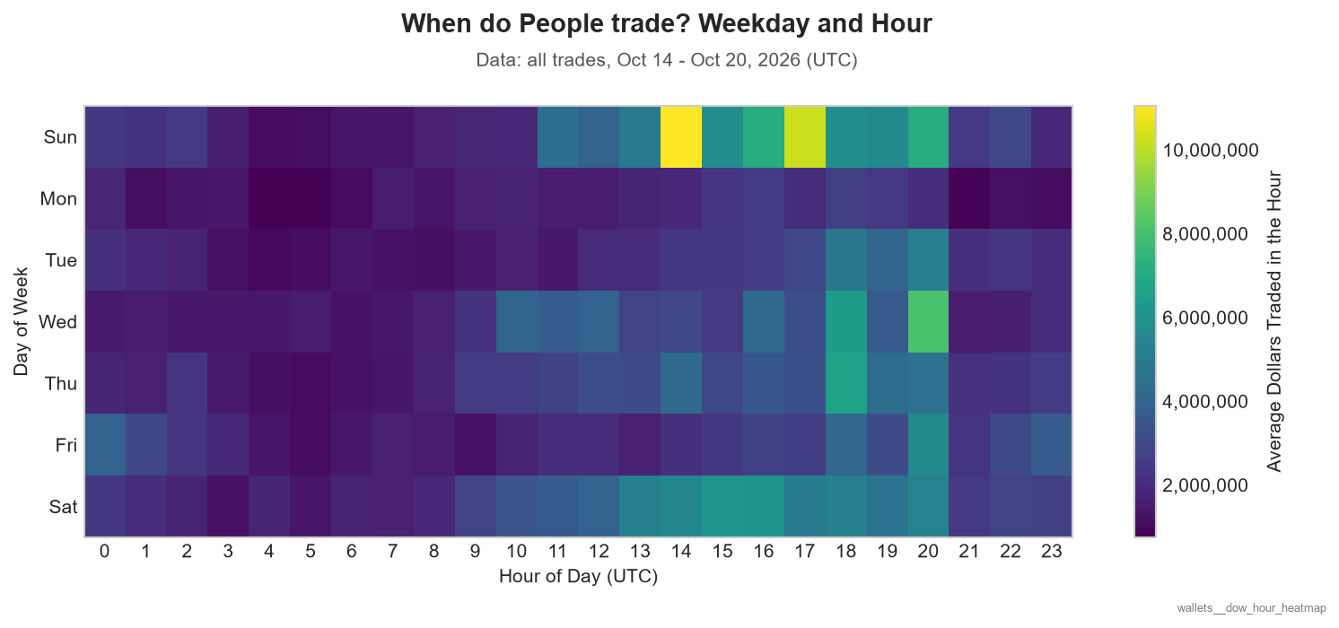
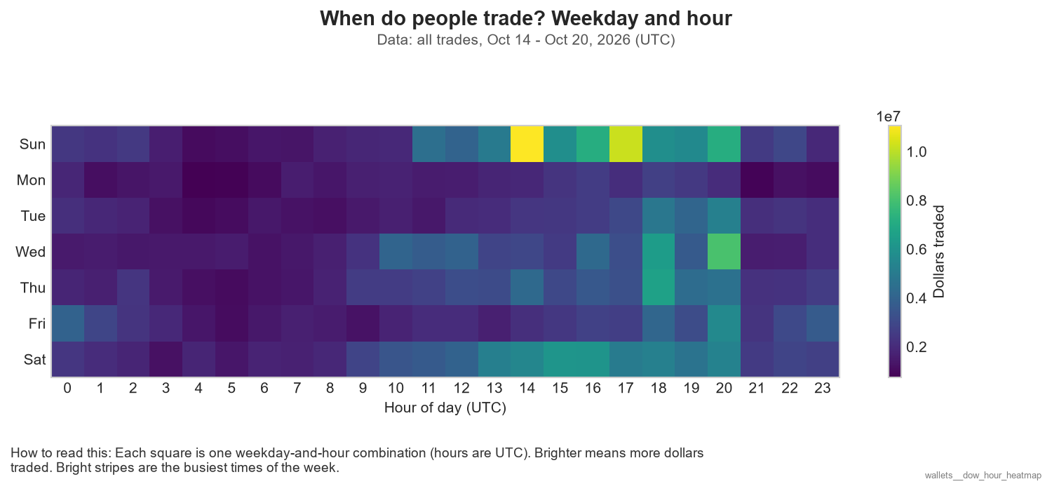
Data: Wallet Trades, Oct 14 - 20
Notes:
Looking at the amount of $ traded between weekdays and hours, it appears that trades mostly occur during the weekends, while Tuesday-Friday trades peak around 6-8 PM, which occur after a standard 9-5 adult workday.

Slide 12
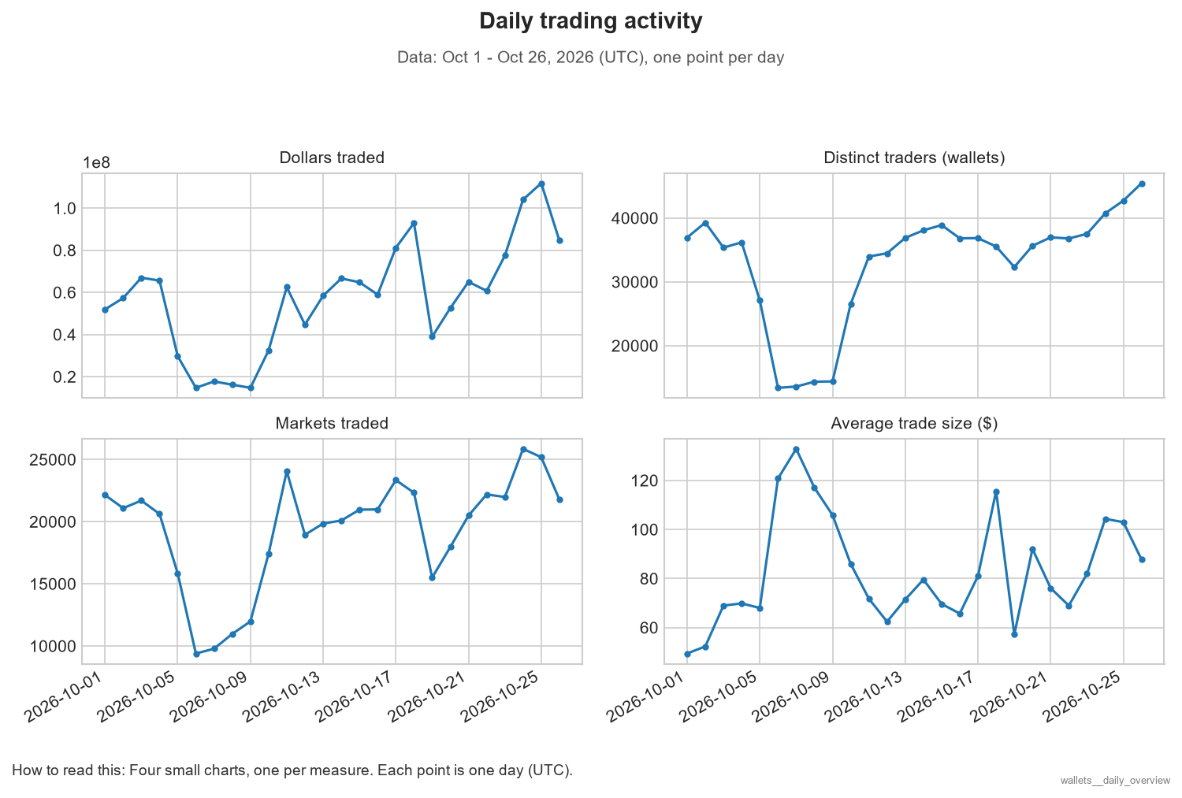
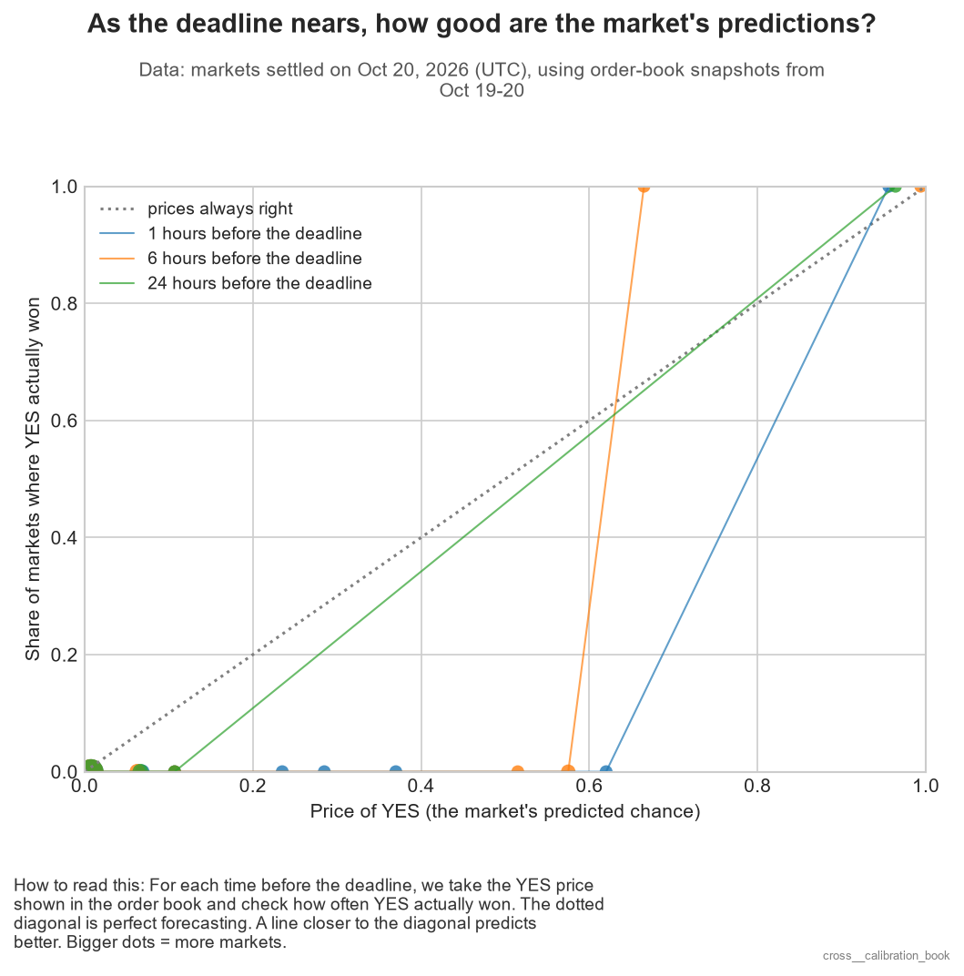
Data: Wallet Trades, Oct 1-26
Notes:
Looking at the plots on the right, they show that as the number of distinct traders increases, the average trade size decreases. A lot of common people with smaller wallets are joining the fray to bet on a market, perhaps a big one.

Slide 13
Joined Tables Data

Slide 14
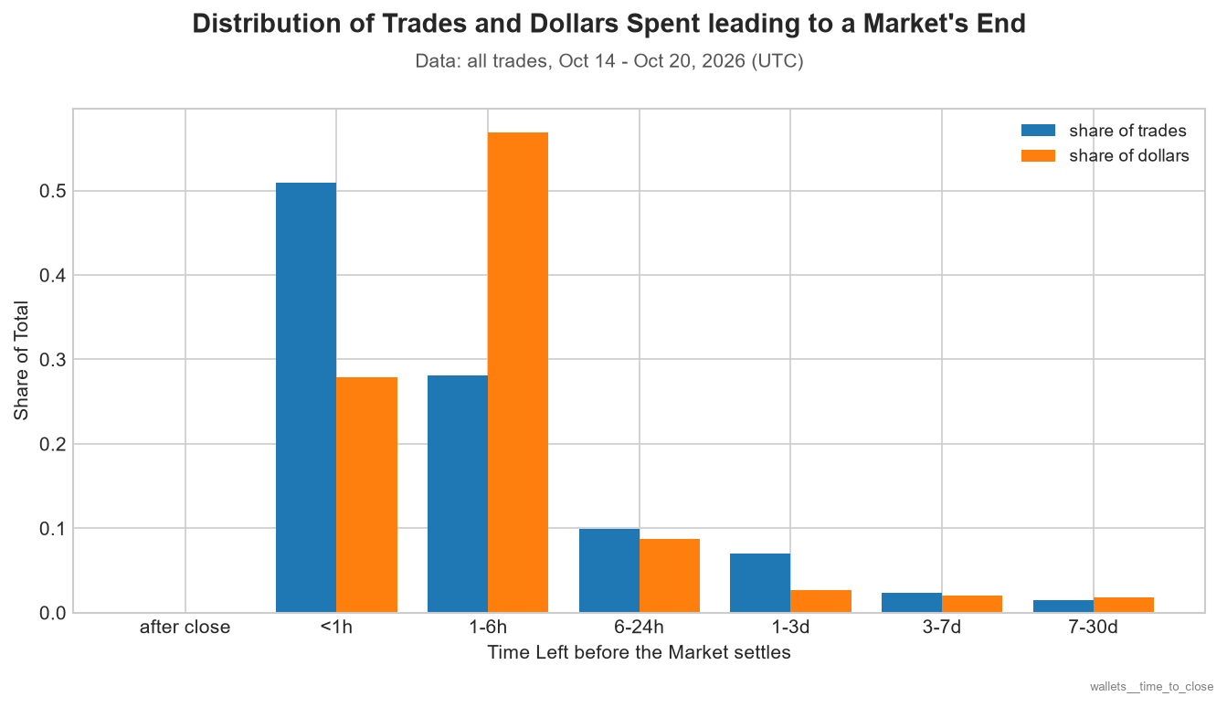
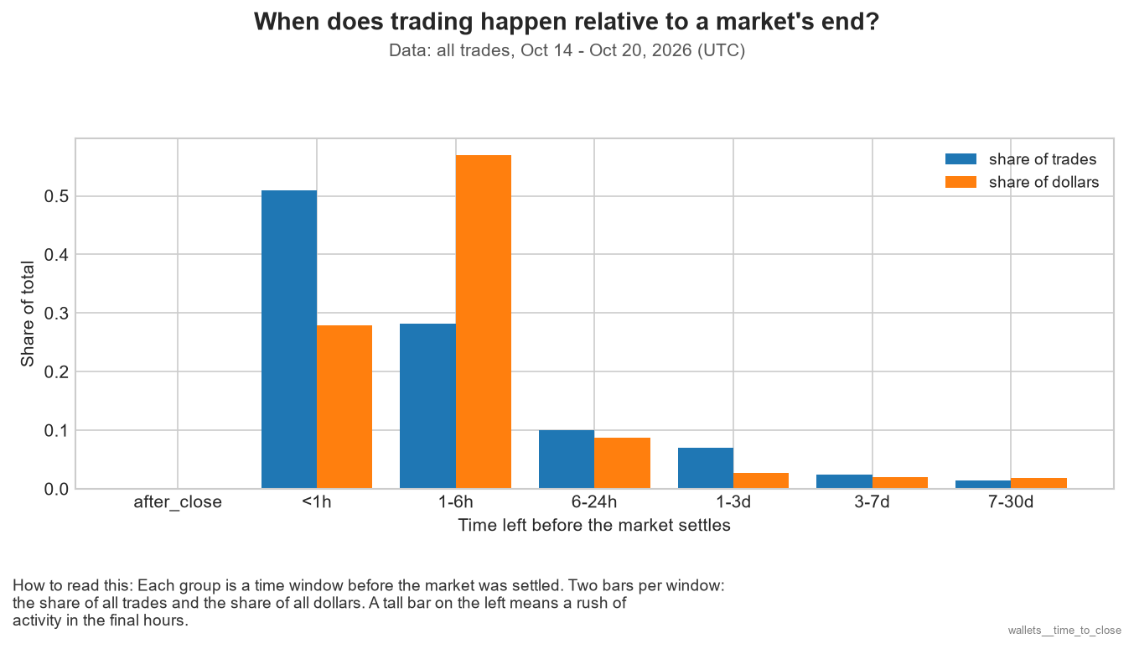
Data: Wallet Trades x Resolutions, Oct 14 - 20
Notes:
Between 1-6 hours before the market ends, most of the money gets thrown around. However, it’s actually LESS than an hour before closing that more than 50% of trades come in...although the trades are smaller.
Most of the trades happening so close to the deadline may show that the markets are short-lived and volatile.
On the other hand, traders with more money may want to act before the market settles within the last hour, while there’s more uncertainty in the air. Perhaps this is actually a ploy to influence the betting odds, as being able to influence a large number of trades would result in price shifts/

Slide 15
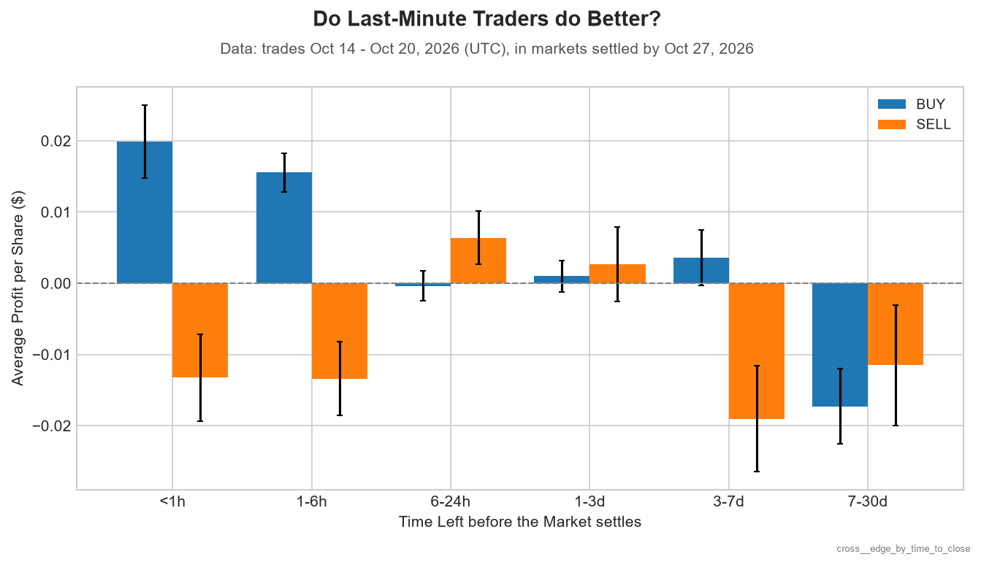
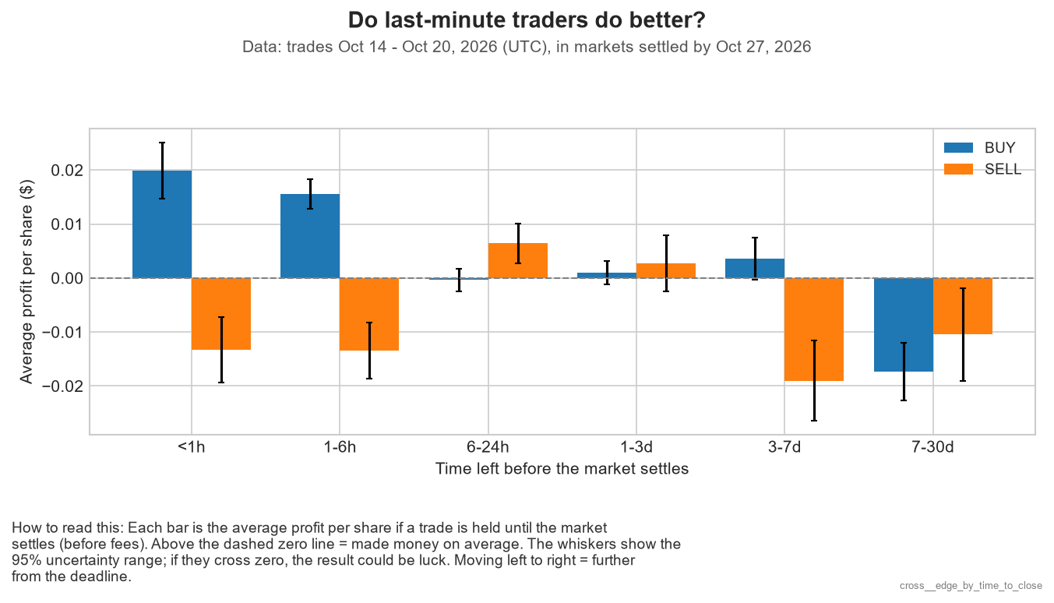
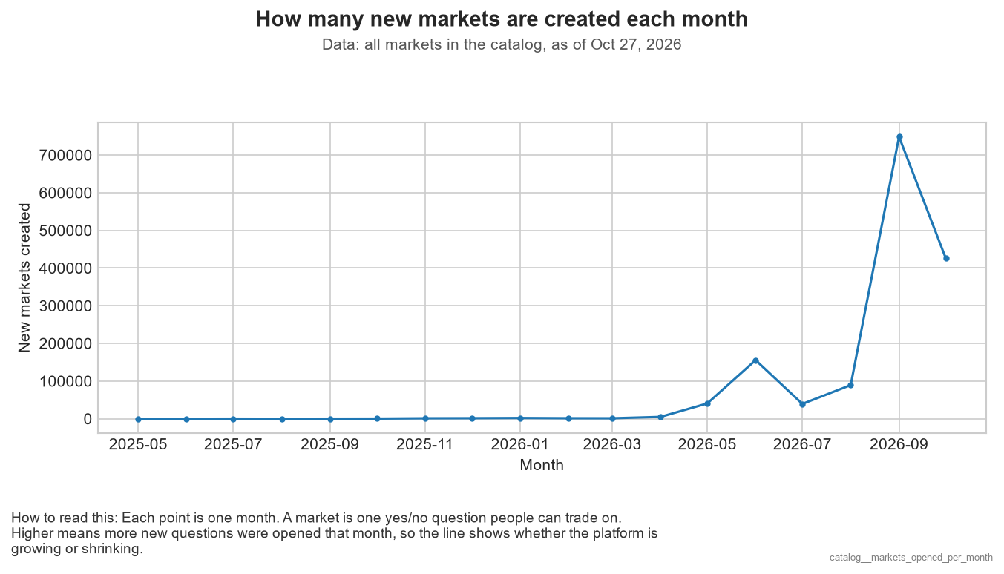
Data: Wallet Trades x Resolutions, Oct 14 - 20
Notes:
Looking at October 14th-20th, we can see that last minute buyers… tend to profit moreso, while last minute sellers lose out.
Perhaps this was a result of panic selling on the sellers’ end, though it’s not so verifiable. They’re trying to minimize their losses; this could occur during a very close basketball game, for instance.
Hence, I’d actually be curious to look at the distribution of topics for these last minute trades, as for example, in sports like Basketball, the score can flip so easily in the final minutes.
On the flip side, people who buy or sell days or weeks in advance tend to lose out; maybe this can be attributed to them not accounting for unpredictable events.

Slide 16
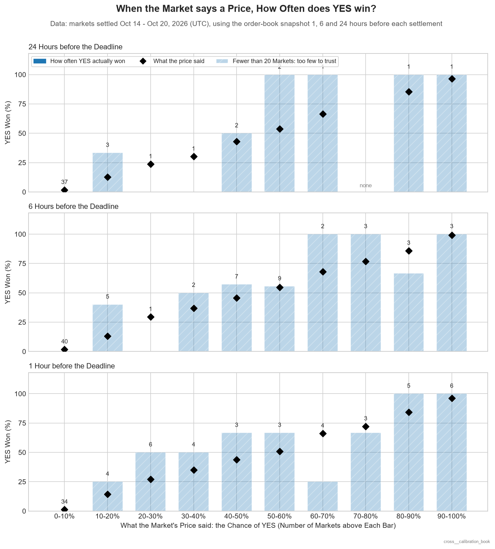
Data: Order Books x Resolutions x Markets, Oct 14 - 20
Notes:
Blue bar higher: YES outcome occurs more often than the price of the share.
Although there’s only a week of data to go off of, it seems that although a YES share may be at a certain price between $0 and $1, there could be a very noticeable discrepancy between the % of YES predictions coming to pass and the actual price, showing that perhaps the platform’s odds could actually be far off from the odds in reality.
Between bets placed at 24 hours, 6 hours, and 1 hour prior to the deadline, lower priced ‘YES’ bets placed further away from the deadline tended to fail miserably more often.

Slide 17
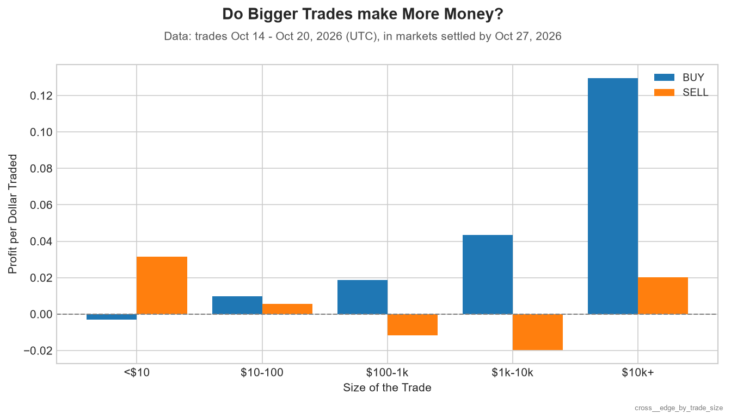
Data: Wallet Trades x Resolutions
Notes:
Huge BUY at a large trade size: insider trading?

Slide 18
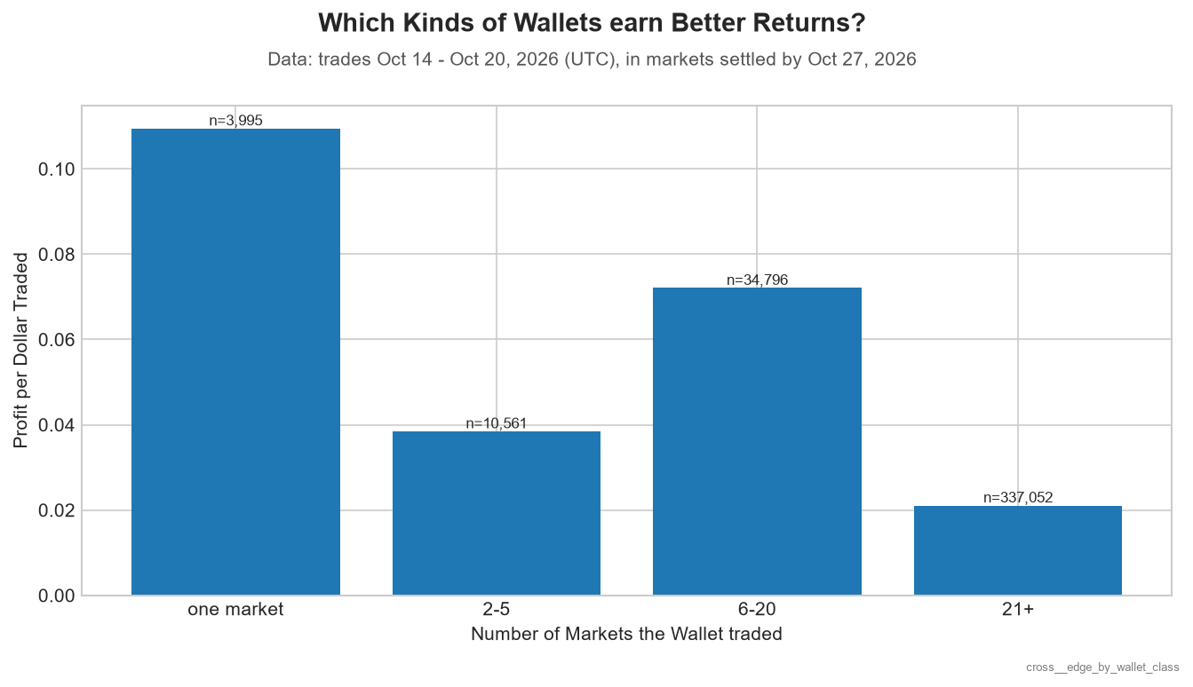
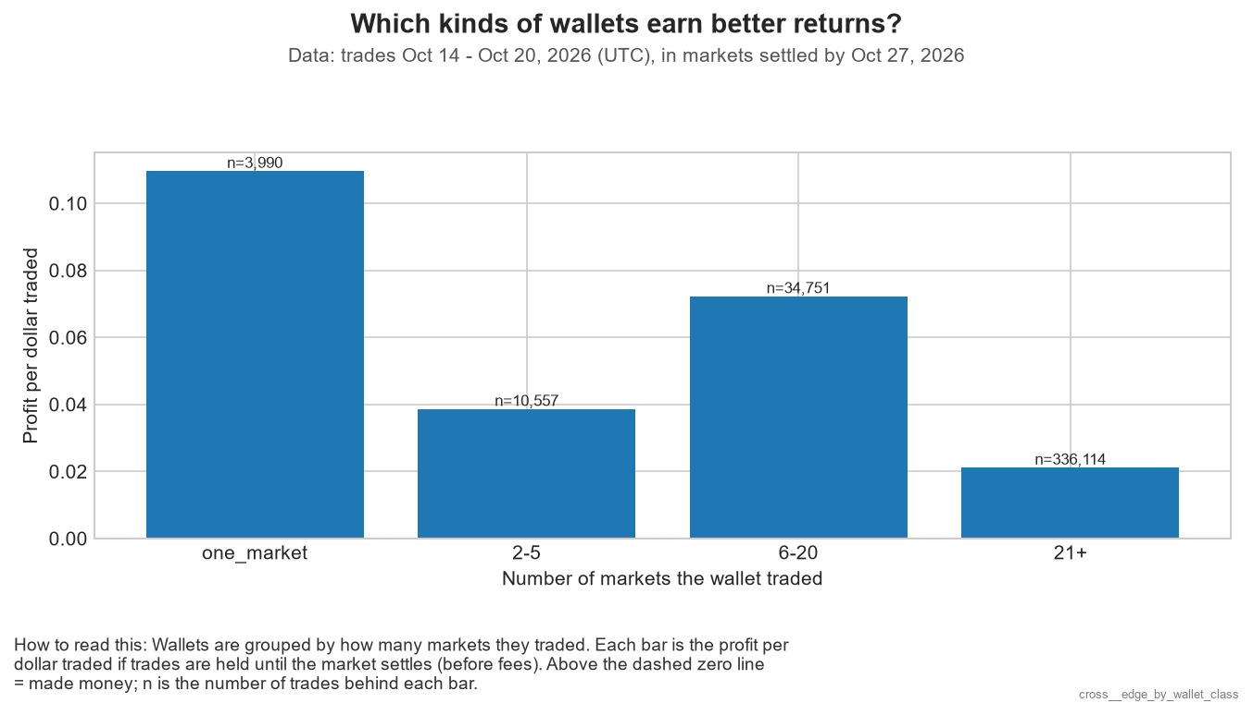
Data: Wallet Trades x Resolutions

Slide 19
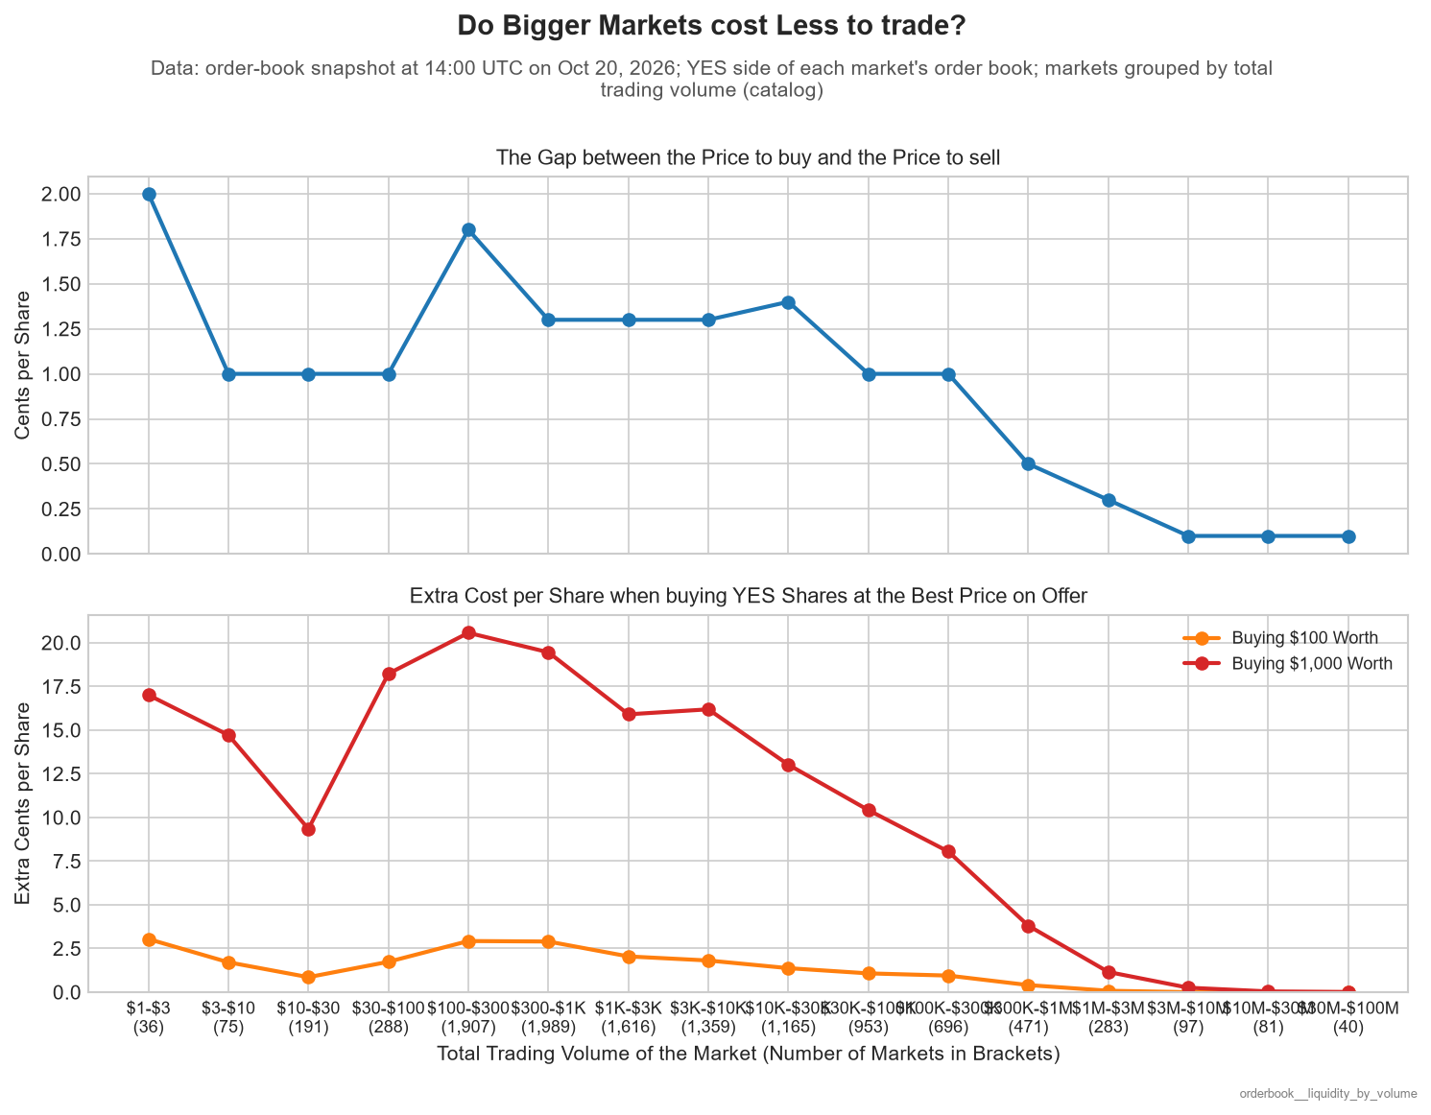
Data: Snapshot x Markets
Notes:
On the bottom graph with the red and orange lines, imagine this: supposing the trading volume of the market is big, there are a lot of buyers and sellers. Hence, usually, a $100 or $1000 purchase in such a big market doesn’t actually cause them to buy up as many shares that are of a higher price, given there are more lower price shares around.

Slide 20
Summary and Conclusion
The top ~1% of markets generate over 80–90% of all platform trading volume.
A small fraction of traders making very large trades drive almost all the dollar volume.
Market creation surged dramatically in late 2026 (peaking over 700k new markets/month in Sept 2026), likely driven by short-duration sports/micro-events.
Dollar volume is heavily clustered around specific high-activity windows, peaking sharply on Sundays between 2 pm and 5 pm UTC while early morning UTC hours (03:00 am – 07:00 am UTC) show minimal trading volume.

Slide 21
Summary and Conclusion
Trends
Last-minute BUY orders (<6h before market close) yield statistically significant positive returns.
Trades over $10,000+ generate the highest profit per dollar traded (>12%), while small trades (<$10) suffer negative returns.
Targeted wallets (trading 1 market or 6–20 markets) achieve higher profit margins than hyper-active wallets trading 21+ markets.
Polymarket prices big markets to perfection, while niche markets are where specialists make their money.

Slide 22
THANK YOU!

